Slide 1
Thermal design for GS0650111L

Slide 2
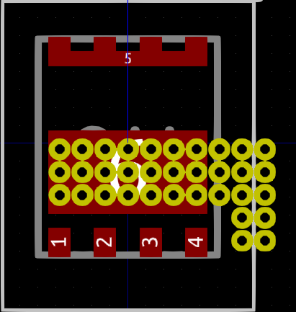
Drain
Have to manually add copper over these vias as the footprint is solder mask defined and no option in kicad for solder mask covered portions of pads
GS0650111L
PCB
Vias
Aluminium block
Thermal Interface
Source
Gate
Heatsink

Slide 3
Component | Rth | Specification
Junction to case | 1.4 | Package
Vias | 4.6 | 34 x 0.3mm Dia 18μm plating (allPCB) , 1 mm thickness PCB, PCB uses 2oZ copper
Thermal interface | 0.388 | 6.5 x 6.2 mm (area of entire device + addition side bit to full height) Hi-flow 300p 0.25mm
Aluminium block | 0.605 | Size of above 5mm thick
Thermal interface | 0.388 | As above
Heatsink | 3 | Typical value, the heat sink will be shared between other devices so is best modelled as a constant temperature sink in this scenario. We will need to keep this below 50c for safety reasons.
Device thermal impedance minimum (not including heat sink and spreading increases) = 7.381 k/W, maximum junction temp 150C, if we assume heat sink is held below 50c this means maximum dissipation is 13.5W, however we should realise that aspects of this analysis are optimistic and dissipation is increased at high junction temps. Therefore we shall aim for <6.8W per device dissipation

